Slide 1
Database Systems
Query Optimization
何明昕 HE Mingxin, Max
Send your email to c.max@yeah.net with
a subject like: DBS345-Andy: On What …
Download from c.program@yeah.net
/文件中心/网盘/DatabaseSystems2021

Slide 2
Query Optimization
Disaster-prevention mode!

Slide 3
DBMS Architecture
Web Forms
Application Front Ends
SQL Interface
SQL Commands
Query Evaluation Engine
Plan Executor
Parser
Operator Evaluator
Optimizer
Transaction Manager
File and Access Methods
Recovery Manager
DBMS
Concurrency Control
Buffer Manager
Storage Manager
Lock Manager
Disk Space Manager
Index Files
Database
System Catalog
Data Files

Slide 4
Recap
Memory hierarchy and secondary storage
Buffer management and replacement policies
File, page and record organizations
Indexing and access paths
Evaluating relational operators
Query optimization
Putting all the above together to efficiently answer queries

Slide 5
Example
SELECT DISTINCT P.buyer
FROM Purchase P,
Person Q
WHERE P.buyer=Q.name AND
Q.city=‘Madison’
ORDER BY P.buyer
𝜏_{buyer}
Assume that
Purchase has a B+tree index on buyer and Person has a B+tree index on city
𝜋_{buyer}
⨝_{buyer=name}
Logical Query Plan
Purchase
𝜎_{city = ‘Madison’}
Person
External Merge-sort
Quicksort for Internal, B=20
Sort-based Projection
Index Nested Loop Join
Hash-based Projection
Hash Join
Physical Query Plans
Indexed Scan
Table Scan
Purchase
Person
Table Scan
B+tree Scan (Index Leaf Nodes)
Purchase
Person

Slide 6

Query Optimization
A given logical query plan (LQP) can have several possible physical query plans (PQP) with (potentially) different costs
Ideal goal: for any given LQP
Create the space of all possible PQPs
Estimate the cost of each plan
Pick the optimal (i.e. cheapest/fastest) PQP

Slide 7
Query Optimization (Cont.)
Real-world goal: just prevent the disaster; i.e. avoid the clearly awful PQPs
“Query optimization is a metaphor for life itself! It is hard to even know what an optimal plan would be, but it is feasible to avoid the obviously bad plans!” –Jeff Naughton

Slide 8
Query Execution
SQL Query
Query Parser
LQP
Query Optimizer
Plan Generator
Catalog
Plan Cost Estimator
Optimized PQP
Query Plan Evaluator
Operator Evaluators

Slide 9
Plan Generator
Also called plan enumerator
Explores various PQPs for a given LQP
Challenge: space of all possible plans is huge
Use rules to help determine what plans to enumerate, and also consults cost models
Two main types of rules for enumerating plans
Logical: algebraic rewrites
Use relational algebraic equivalence to rewrite LQP itself
Physical: various physical implementations of operations
Use different implementations for a given logical operation in LQP

Slide 10
Algebraic Rewriting
Rewrite a given RA query into another that is equivalent (a logical property) but might be faster (a physical property)
Exploit formal properties of RA operators
A few rewrite rules
Single-operator Rewrites
Unary operators
Binary operators
Cross-operator Rewrites

Slide 11


Algebraic Rewriting: Example
𝜏_{buyer}
𝜏_{buyer}
𝜏_{buyer}
𝜋_{buyer}
𝜋_{buyer}
𝜋_{buyer}
𝜎_{total} _{> 25}
𝜎 _{city = ‘Madison’}
𝜎_{city = ‘Madison’ ∧ total > 25}
𝜎_{city = ‘Madison’}
𝜎_{total} _{> 25}
⨝_{buyer=name}
𝜏_{buyer}
𝜏_{buyer}
⨝_{buyer=name}
⨝_{buyer=name}
Purchase
Person
𝜋_{buyer}
𝜋_{buyer}
Purchase
Person
𝜎_{total} _{> 25}
Purchase
Person
𝜎 _{city = ‘Madison’}
⨝_{buyer=name}
⨝_{buyer=name}
Purchase
𝜎_{city = ‘Madison’}
𝜎_{total} _{> 25}
Person
Person
Purchase

Slide 12
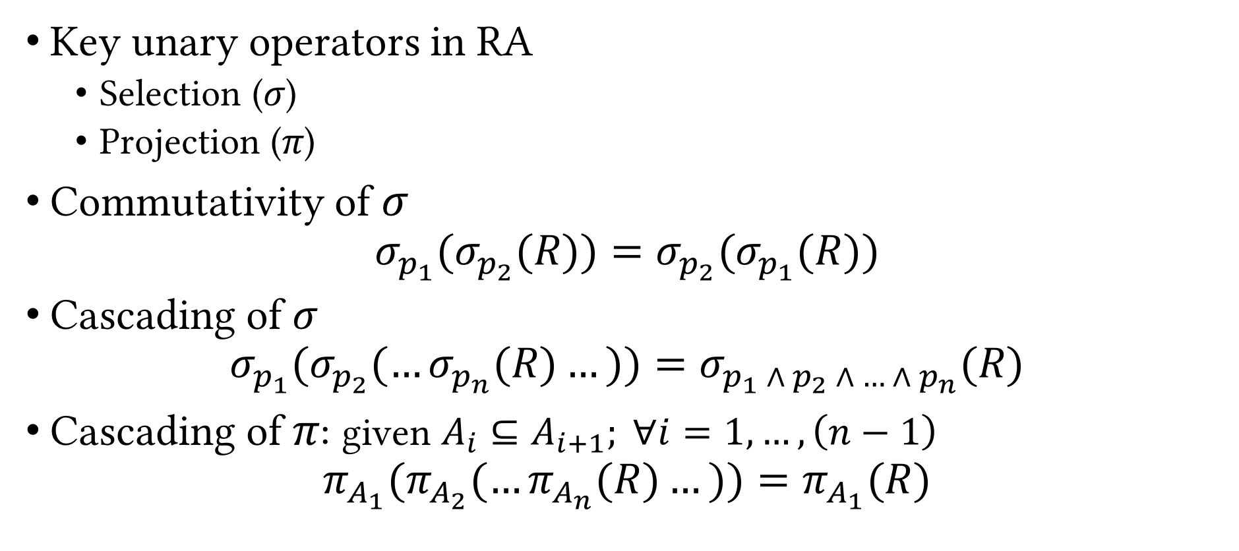
Algebraic Rewriting: Unary Operators
Key unary operators in RA
Selection (𝜎)
Projection (𝜋)
Commutativity of 𝜎 $σ_{p_{1}}(σ_{p_{2}}(R))=σ_{p_{2}}(σ_{p_{1}}(R))$
Cascading of 𝜎 $σ_{p_{1}}(σ_{p_{2}}(…σ_{p_{n}}(R)…))=σ_{p_{1} ∧ p_{2} ∧ … ∧ p_{n}}(R)$
Cascading of 𝜋: given $A_{i}⊆A_{i+1}; ∀i=1,…,\left(n−1\right)$ $π_{A_{1}}(π_{A_{2}}(…π_{A_{n}}(R)…))=π_{A_{1}}(R)$

Slide 13
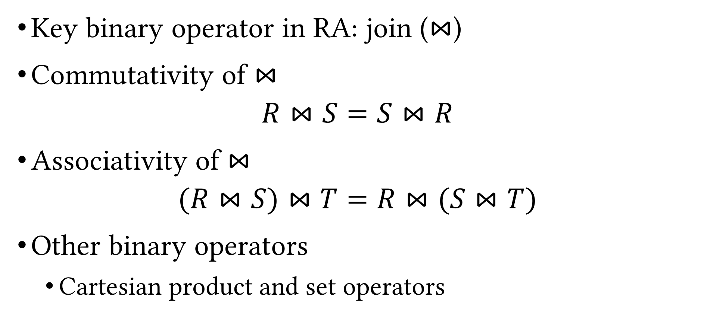
Algebraic Rewriting: Binary Operators
Key binary operator in RA: join ($⋈$)
Commutativity of $⋈$ $R⋈S=S⋈R$
Associativity of $⋈$ $(R⋈S)⋈T=R⋈(S⋈T)$
Other binary operators
Cartesian product and set operators
Which ones satisfy the above properties?

Slide 14
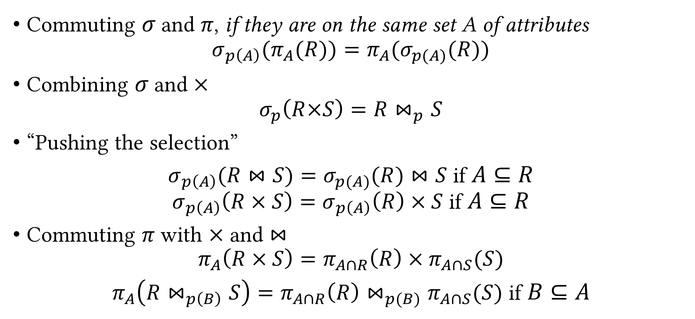
Cross-operator Algebraic Rewriting
Commuting 𝜎 and 𝜋, if they are on the same set A of attributes $σ_{p\left(A\right)}(π_{A}(R))=π_{A}(σ_{p(A)}(R))$
Combining 𝜎 and $×$ $σ_{p}\left(R×S\right)=R⋈_{p}S$
“Pushing the selection”
$σ_{p\left(A\right)}(R⋈S)=σ_{p(A)}(R)⋈S$ if $A⊆R$ $σ_{p\left(A\right)}\left(R × S\right)=σ_{p\left(A\right)}\left(R\right) × S$ if $A⊆R$
Commuting 𝜋 with $×$ and $⋈$ $π_{A}\left(R × S\right)=π_{A∩R}\left(R\right) × π_{A∩S}(S)$
$π_{A}\left(R⋈_{p\left(B\right)}S\right)=π_{A∩R}\left(R\right)⋈_{p(B)}π_{A∩S}(S)$ if $B⊆A$

Slide 15
Algebraic Rewriting: Example
𝜋_{B}
⨝
⨝
𝜋_{B}
𝜋_{B}
R(A,B)
S(B,C)
R(A,B)
S(B,C)
Why might we prefer this plan?

Slide 16
Algebraic Rewriting (Cont.)
Basic commutators
Push projection through
Selection
Join
Push selection through
Selection
Projection
Join
Re-ordered joins
NOT an exhaustive set of rewriting rules

Slide 17
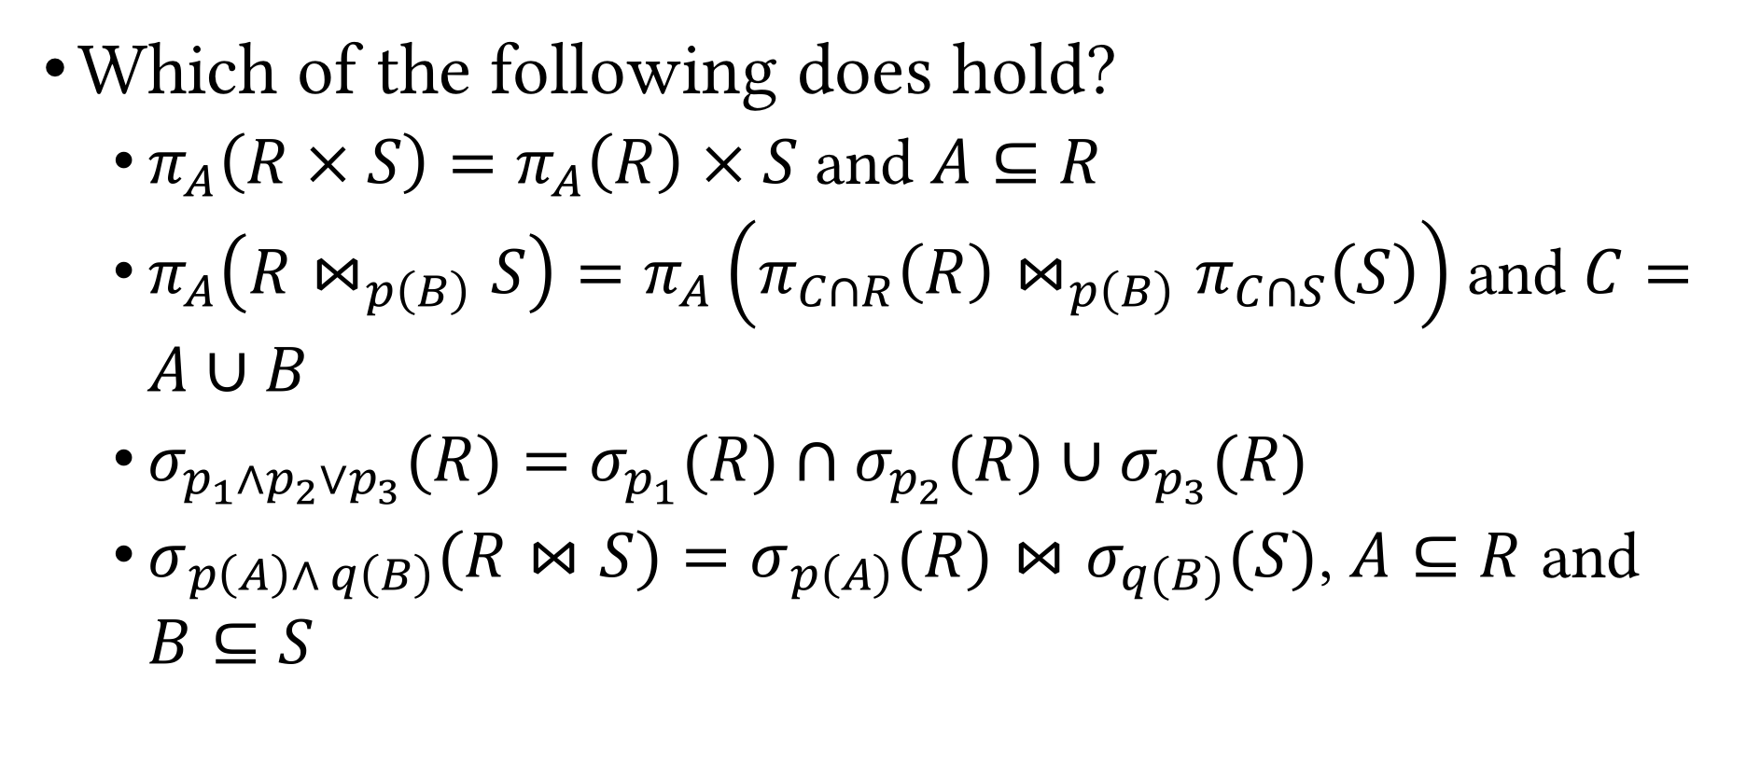
Algebraic Rewriting: Example (Cont.)
Which of the following does hold?
$π_{A}\left(R × S\right)=π_{A}\left(R\right) × S$ and $A⊆R$
$π_{A}\left(R⋈_{p\left(B\right)}S\right)=π_{A}\left(π_{C∩R}\left(R\right)⋈_{p\left(B\right)}π_{C∩S}\left(S\right)\right)$ and $C=A∪B$
$σ_{p_{1}∧p_{2}∨p_{3}}(R)=σ_{p_{1}}(R)∩σ_{p_{2}}(R)∪σ_{p_{3}}(R)$
$σ_{p\left(A\right)∧ q\left(B\right)}(R⋈S)=σ_{p\left(A\right)}(R)⋈σ_{q(B)}(S)$, $A⊆R$ and $B⊆S$

Slide 18
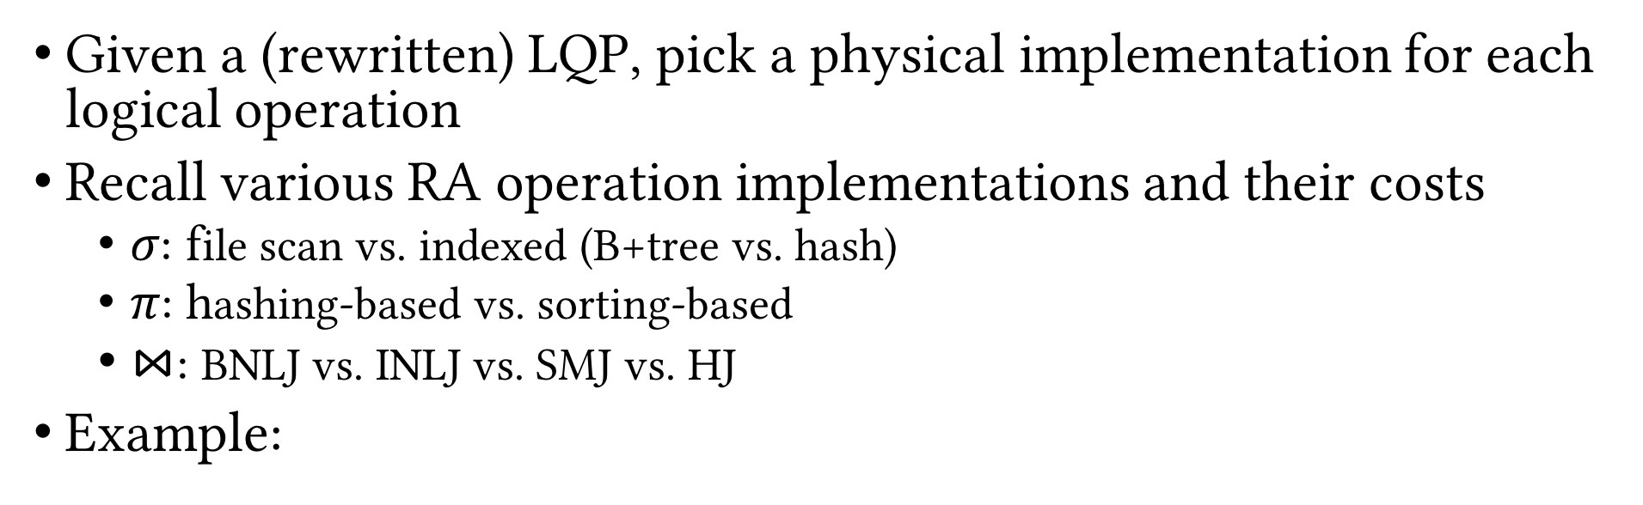
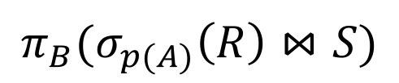
Choose Physical Operation Implementation
Given a (rewritten) LQP, pick a physical implementation for each logical operation
Recall various RA operation implementations and their costs
𝜎: file scan vs. indexed (B+tree vs. hash)
𝜋: hashing-based vs. sorting-based
$⋈$: BNLJ vs. INLJ vs. SMJ vs. HJ
Example:
$$π_{B}{(σ}_{p(A)}\left(R\right)⋈S)$$
16 PQPs
How many with logical rewrites?
2 options
2 options
4 options

Slide 19
Choose Operation Implementation: Factors
Are the indexes clustered or unclustered?
Are there multiple matching indexes?
Are index-only access paths possible for some operations?
Are there “interesting orders” among the tuples?
Would sorted outputs benefit downstream operations?
Estimated cardinalities of intermediate results?
How best to reorder multi-table joins?
Hard, open research problem

Slide 20

Join Orderings
Exponential number of orderings
Associativity of join
Example: $R⋈S⋈T⋈U$
Almost all RDBMSs consider only left-deep join trees
Enables easy pipelining
⨝
⨝
⨝
⨝
U
R
⨝
⨝
⨝
⨝
T
S
⨝
R
T
U
R
S
S
T
U
Bushy tree
Left-deep tree
Right-deep tree

Slide 21
Materialization vs. Pipelining
Intermediate results
Materialized
Stored in a temporary relation
When the execution of the corresponding operation is finished, pass the temp table to the next operation
Pipelined
Pass the intermediate results on-the-fly (as they are generated by the upstream operation)
Benefits
Display the outputs to the user incrementally
Parallelize execution on multi-core CPUs

Slide 22
Blocking Operations
External Merge-sort
Quicksort for Internal, B=20
External Merge-sort
Quicksort for Internal, B=20
Hash join results can be pipelined to projection
Hash-based Projection
Hash-based Projection
Sorting results have to be materialized and cannot be pipelined
Hash Join
Sort-merge Join
Table Scan
B+tree Scan (Index Leaf Nodes)
Table Scan
Table Scan
Purchase
Person
Purchase
Person

Slide 23
Iterator Interface
Enables us to abstract away individual physical operation implementation details
Makes pipelining easier
Each physical operation should support three functions
Open(): initialize the operation’s “state”, get arguments, allocate input and output buffers
GetNext(): ask the operation to “deliver” next output tuple; pass it on; if blocking, wait
Close(): clear operation’s state, free up space

Slide 24
Plan Cost Estimation
Do not know the exact cost of PQPs (why?)
For each PQP considered by the plan generator, the plan cost estimator computes estimated cost of the PQP
Weighted sum of plan operations’ I/O costs and CPU costs
Distributed RDBMSs also include network cost
Challenge: Given a PQP, compute overall cost
Pipelining vs. blocking ops; cannot simply add costs
Hard to estimate cardinality of intermediate relations
Remember we ignored OUTPUT cost!?

Slide 25
Plan Cost Estimation (Cont.)
Estimating the cost of a query plan involves
Estimating the cost of each operation in the plan, which depends on
Input cardinalities
Algorithm cost (known)
Estimating the cardinalities of intermediate results
Need statistics about input relations
Tracked in system catalog

Slide 26
System Catalog
Set of pre-defined relations for metadata about DB (schema)
For each relation
Relation name,
File name and structure (heap file, clustered B+tree, etc.)
Attribute names and types
Integrity constraints
Indexes
For each index
Index name, structure (B+tree, hash, etc.), search key
For each view
View name
View definition

Slide 27
System Catalog: Example
SQLite
select * from sqlite_master;
type name tbl_name rootpage sql
---------- ---------- ---------- ---------- ----------------------------------------------------table User User 2 CREATE TABLE User ( UID CHAR(20), Name CHAR(50), ...
index sqlite_aut User 3 table Event Event 4 CREATE TABLE Event ( EID CHAR(20), Name CHAR(50),...
index sqlite_aut Event 5 table Participat Participat 6 CREATE TABLE ParticipateIn ( EID CHAR(20), UID CH...
index sqlite_aut Participat 7

Slide 28
Statistics in System Catalog
RDBMS periodically collects stats about the data
Can be slightly out-of-date
For each table R
Cardinality, i.e., number of tuples, NTuples(R)
Size, i.e., number of pages, NPages(R), or just N_{R}
For each Index X
Cardinality, i.e., number of distinct keys IKeys(X)
Size, i.e., number of pages IPages(X) (for a B+ tree, this is the number of leaf pages only)
Height (for tree indexes) IHeight(X)
Min and max key values in index ILow(X), IHigh(X); i.e. key ranges
More advanced query optimizers
Histograms
Wavelets

Slide 29
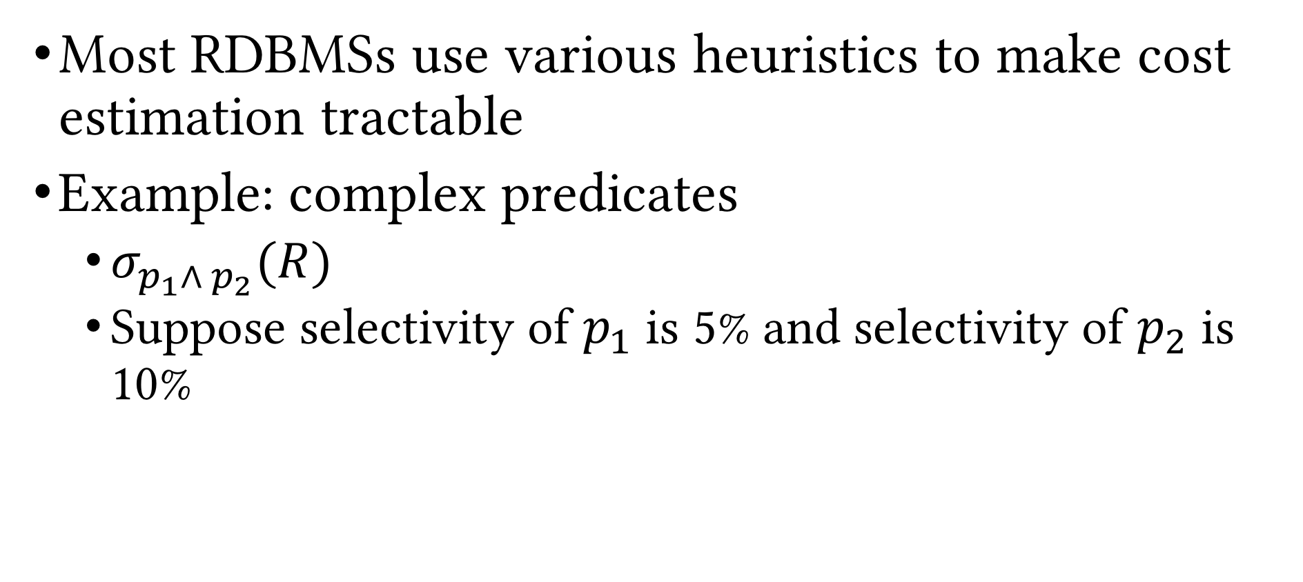
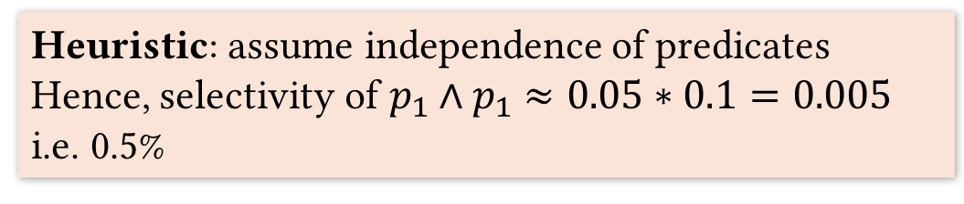
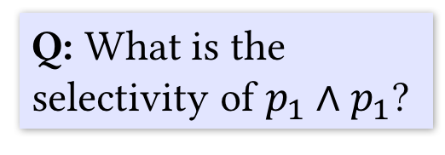
Plan Cost Estimation (Cont.)
Most RDBMSs use various heuristics to make cost estimation tractable
Example: complex predicates
$σ_{p_{1}∧ p_{2}}(R)$
Suppose selectivity of $p_{1}$ is 5% and selectivity of $p_{2}$ is 10%
Q: What is the selectivity of $p_{1}∧p_{1}$?
Heuristic: assume independence of predicates
Hence, selectivity of $p_{1}∧p_{1}$ $≈0.05∗0.1=0.005$
i.e. 0.5%
A: Not enough info!

Slide 30
Example: System R Query Optimizer
Unit of optimization: query block
Example
Optimize one block at a time
Treat nested blocks as calls to a subroutine
Execute inner block once per outer tuple
In reality more complex optimization
For each block, consider the following plans
All available access paths, for each relation in FROM clause
All join permutations of left-deep join trees
SELECT S.name
FROM Student S
WHERE S.age IN
(SELECT MAX (S2.age)
FROM Student S2
GROUP BY S2.class)
Outer block
Nested block

Slide 31
System R Optimizer: Plan Enumeration
Two main cases
Single-relation plans
Multiple-relation plans
Single-relation plan (no joins)
Access paths
File scan
Index scan(s)

Slide 32
System R Optimizer: Single-relation Plans
Index scan(s)
Clustered, non-clustered
More than one index may “match” predicates
One (clustered) index X matching one or more selects
Cost = (IPages(X)+NPages(R)) * product of reduction factors of matching selects
Choose the plan with the least estimated cost
Merge/pipeline selection and projection (and aggregate)
rid intersection techniques
Index aggregate evaluation

Slide 33
System R Optimizer: Example
Employee(SSN, Name, Address, Salary, DeptID)
1,000 data pages
10K tuples
100 pages in B+tree
#depts: 10
Salary range: 10K–200K
SELECT Name
FROM Employee
WHERE DeptID = 8 AND
Salary > 40000
B+tree index on DeptID
#tuples retrieved: (1/10) * 10,000
Clustered index: (1/10) * (100+1,000) pages
Unclustered index: (1/10) * (100+10,000) pages
B+tree index on Salary
Clustered index: (200-40)/(200-10) * (100+1,000) pages
Unclustered index: …
File scan: 1,000 pages

Slide 34
Recap
Plan generator and cost estimator work in tandem
Rules determine what PQPs are enumerated
Logical: algebraic rewrites of LQP
Physical: operation implementations and ordering alternatives
Cost models and heuristics help approximating the costs of the PQPs
Active research area
Parametric query optimization, multi-objective query optimization, multiple query optimization, online query optimization, dynamic re-optimization, etc.

Slide 35
Recap
Logical vs physical query plans
Relational query optimization: given a logical query plan, find a PQP that is not clearly awful!
Query optimizer components
Plan generator/enumerator: generate a subset of all possible PQP
Plan cost estimator: estimate the cost of each PQP and pick the fastest one to execute

Slide 36
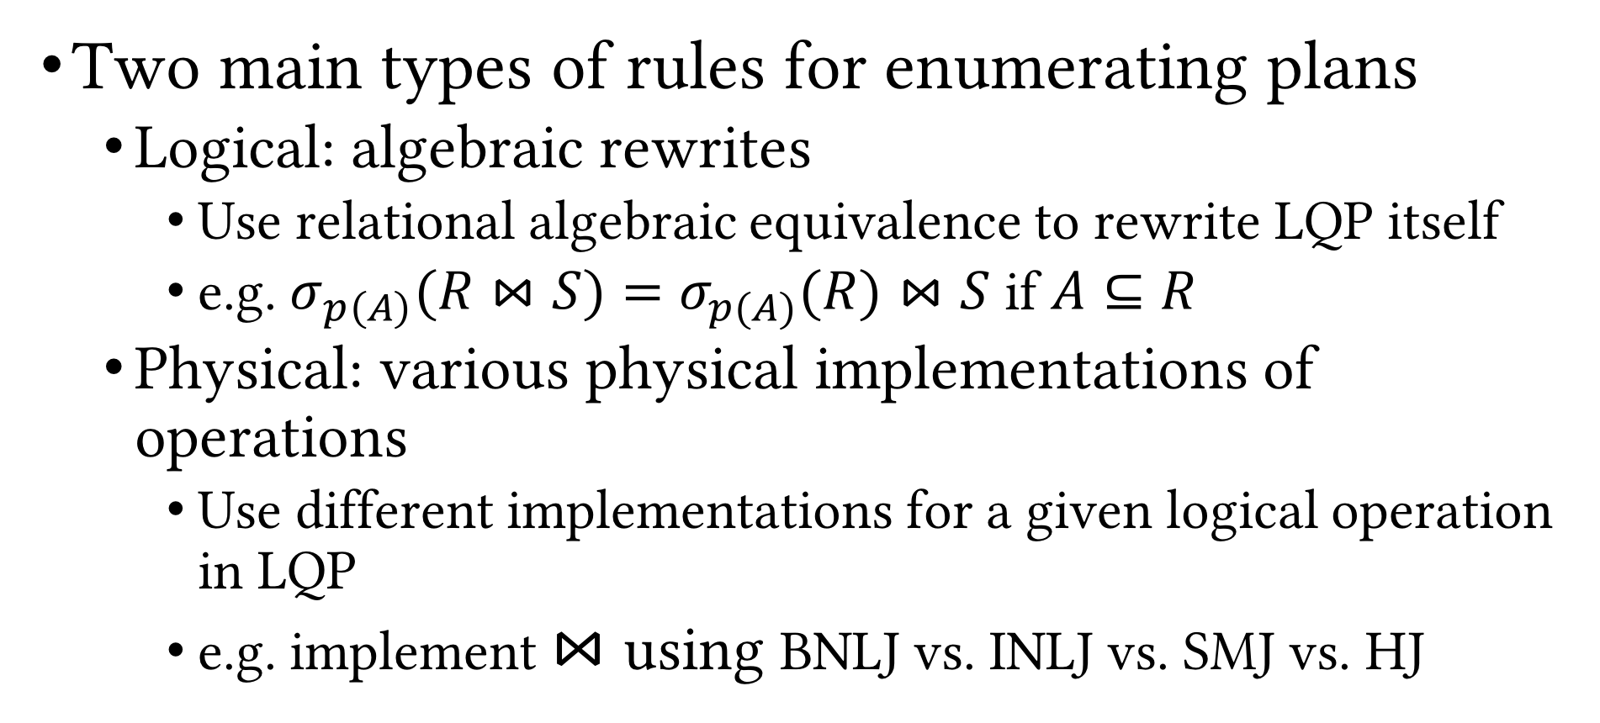
Recap (Cont.)
Two main types of rules for enumerating plans
Logical: algebraic rewrites
Use relational algebraic equivalence to rewrite LQP itself
e.g. $σ_{p\left(A\right)}(R⋈S)=σ_{p(A)}(R)⋈S$ if $A⊆R$
Physical: various physical implementations of operations
Use different implementations for a given logical operation in LQP
e.g. implement $⋈$ using BNLJ vs. INLJ vs. SMJ vs. HJ

Slide 37
Recap (Cont.)
Join orderings
Bushy, left-deep or right-deep
Materialization vs. pipelining
Benefits of pipelining
Display the outputs to the user incrementally
Parallelize execution on multi-core CPUs
⨝
⨝
⨝
⨝
⨝
U
R
⨝
⨝
⨝
T
S
⨝
R
T
U
S
R
S
T
U

Slide 38
Blocking Operations
External Merge-sort
Quicksort for Internal, B=20
External Merge-sort
Quicksort for Internal, B=20
Hash join results can be pipelined to projection
Hash-based Projection
Hash-based Projection
Sorting results have to be materialized and cannot be pipelined
Hash Join
Sort-merge Join
Table Scan
B+tree Scan (Index Leaf Nodes)
Table Scan
Table Scan
Purchase
Person
Purchase
Person

Slide 39
Iterator Interface
Enables us to abstract away individual physical operation implementation details
Makes pipelining easier
Each physical operation should support three functions
Open(): initialize the operation’s “state”, get arguments, allocate input and output buffers
GetNext(): ask the operation to “deliver” next output tuple; pass it on; if blocking, wait
Close(): clear operation’s state, free up space

Slide 40
Plan Cost Estimation
Do not know the exact cost of PQPs (why?)
For each PQP considered by the plan generator, the plan cost estimator computes estimated cost of the PQP
Weighted sum of plan operations’ I/O costs and CPU costs
Distributed RDBMSs also include network cost
Challenge: Given a PQP, compute overall cost
Pipelining vs. blocking ops; cannot simply add costs
Hard to estimate cardinality of intermediate relations
Remember we ignored OUTPUT cost!?

Slide 41
Plan Cost Estimation (Cont.)
Estimating the cost of a query plan involves
Estimating the cost of each operation in the plan, which depends on
Input cardinalities
Algorithm cost (known)
Estimating the cardinalities of intermediate results
Need statistics about input relations
Tracked in system catalog

Slide 42
System Catalog
Set of pre-defined relations for metadata about DB (schema)
For each relation
Relation name,
File name and structure (heap file, clustered B+tree, etc.)
Attribute names and types
Integrity constraints
Indexes
For each index
Index name, structure (B+tree, hash, etc.), search key
For each view
View name
View definition

Slide 43
System Catalog: Example
SQLite
select * from sqlite_master;
type name tbl_name rootpage sql
---------- ---------- ---------- ---------- ----------------------------------------------------table User User 2 CREATE TABLE User ( UID CHAR(20), Name CHAR(50), ...
index sqlite_aut User 3 table Event Event 4 CREATE TABLE Event ( EID CHAR(20), Name CHAR(50),...
index sqlite_aut Event 5 table Participat Participat 6 CREATE TABLE ParticipateIn ( EID CHAR(20), UID CH...
index sqlite_aut Participat 7

Slide 44
System Catalog: Example (Cont.)
PostgreSQL*
Catalog Table Name | Purpose
pg_aggregate | aggregate functions
pg_am | index access methods
pg_amop | access method operators
pg_amproc | access method support procedures
pg_attrdef | column default values
pg_attribute | table columns ("attributes")
pg_authid | authorization identifiers (roles)
pg_auth_members | authorization identifier membership relationships
pg_cast | casts (data type conversions)
pg_class | tables, indexes, sequences, views ("relations")
pg_constraint | check constraints, unique constraints, primary key constraints, foreign key constraints
pg_collation | collations (locale information)
pg_conversion | encoding conversion information
pg_database | databases within this database cluster
pg_db_role_setting | per-role and per-database settings
pg_default_acl | default privileges for object types
pg_depend | dependencies between database objects
pg_description | descriptions or comments on database objects
pg_enum | enum label and value definitions
pg_extension | installed extensions
pg_foreign_data_wrapper | foreign-data wrapper definitions
pg_foreign_server | foreign server definitions
pg_foreign_table | additional foreign table information
pg_index | additional index information
Catalog Table Name | Purpose
pg_inherits | table inheritance hierarchy
pg_language | languages for writing functions
pg_largeobject | data pages for large objects
pg_largeobject_metadata | metadata for large objects
pg_namespace | schemas
pg_opclass | access method operator classes
pg_operator | operators
pg_opfamily | access method operator families
pg_pltemplate | template data for procedural languages
pg_proc | functions and procedures
pg_rewrite | query rewrite rules
pg_seclabel | security labels on database objects
pg_shdepend | dependencies on shared objects
pg_shdescription | comments on shared objects
pg_statistic | planner statistics
pg_tablespace | tablespaces within this database cluster
pg_trigger | triggers
pg_ts_config | text search configurations
pg_ts_config_map | text search configurations' token mappings
pg_ts_dict | text search dictionaries
pg_ts_parser | text search parsers
pg_ts_template | text search templates
pg_type | data types
pg_user_mapping | mappings of users to foreign servers
* https://www.postgresql.org/docs/9.1/static/catalogs-overview.html

Slide 45
Statistics in System Catalog
RDBMS periodically collects stats about the data
Can be slightly out-of-date
For each table R
Cardinality, i.e., number of tuples, NTuples(R)
Size, i.e., number of pages, NPages(R), or just N_{R}
For each Index X
Cardinality, i.e., number of distinct keys IKeys(X)
Size, i.e., number of pages IPages(X) (for a B+ tree, this is the number of leaf pages only)
Height (for tree indexes) IHeight(X)
Min and max key values in index ILow(X), IHigh(X); i.e. key ranges
More advanced query optimizers
Histograms
Wavelets

Slide 46
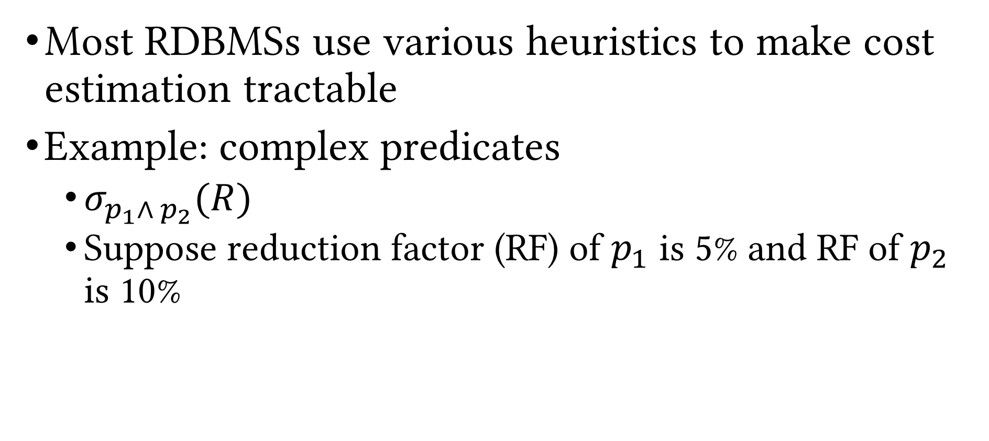
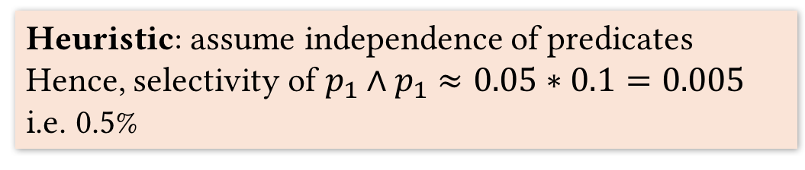

Plan Cost Estimation (Cont.)
Most RDBMSs use various heuristics to make cost estimation tractable
Example: complex predicates
$σ_{p_{1}∧ p_{2}}(R)$
Suppose reduction factor (RF) of $p_{1}$ is 5% and RF of $p_{2}$ is 10%
Q: What is the selectivity of $p_{1}∧p_{1}$?
Heuristic: assume independence of predicates
Hence, selectivity of $p_{1}∧p_{1}$ $≈0.05∗0.1=0.005$
i.e. 0.5%
A: Not enough info!

Slide 47

Example: System R Query Optimizer
System R
First RDBMS to implement SQL
Developed at IBM in the 70’s
Many ideas from System R persist to the day as fundamental building blocks of data management systems
Didn’t have a logo!
What they created in its loving memory

Slide 48
Example: System R Query Optimizer
Unit of optimization: query block
Example
SELECT S.name
FROM Student S
WHERE S.age IN
(SELECT MAX (S2.age)
FROM Student S2
GROUP BY S2.class)
Outer block
Nested block

Slide 49
Example: System R Query Optimizer
Optimize one block at a time
Treat nested blocks as calls to a subroutine
Execute the nested block once per outer tuple
Today, more complex optimization
For each block, consider the following plans
All available access paths, for each relation in FROM clause
All join permutations of left-deep join trees

Slide 50
System R Optimizer: Plan Enumeration
Two main cases
Single-relation plans
Multiple-relation plans
Single-relation plan (no joins)
Access paths
File scan
Index scan(s)

Slide 51
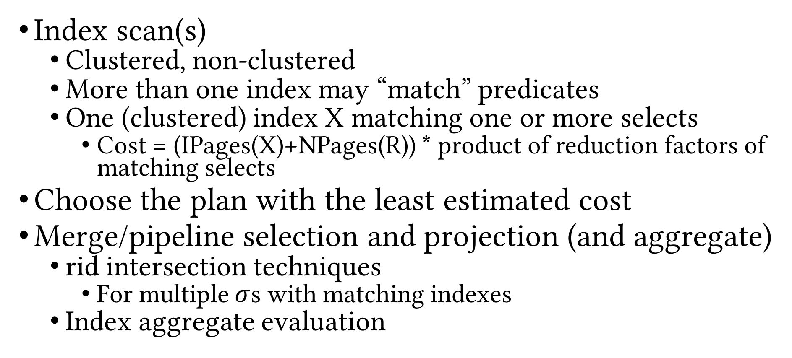
System R Optimizer: Single-relation Plans
Index scan(s)
Clustered, non-clustered
More than one index may “match” predicates
One (clustered) index X matching one or more selects
Cost = (IPages(X)+NPages(R)) * product of reduction factors of matching selects
Choose the plan with the least estimated cost
Merge/pipeline selection and projection (and aggregate)
rid intersection techniques
For multiple $σ$s with matching indexes
Index aggregate evaluation

Slide 52
System R Optimizer: Example
Employee(SSN, Name, Address, Salary, DeptID)
1,000 data pages
10K tuples
100 pages in B+tree
#depts: 10
Salary range: 10K–200K
SELECT Name
FROM Employee
WHERE DeptID = 8 AND
Salary > 40000
File scan: 1,000 pages
B+tree index on DeptID
#tuples retrieved: (1/10) * 10,000
Clustered index: (1/10) * (100+1,000) pages
Unclustered index: (1/10) * (100+10,000) pages
B+tree index on Salary
Clustered index: (200-40)/(200-10) * (100+1,000) pages
Unclustered index: …
What if we have histograms?

Slide 53
System R Optimizer: Multiple-relation Plans
Need to deal with joins
Consider left-deep plans only
Left-deep plans can potentially be fully pipelined
Intermediate results not written to temporary files
Not all left-deep plans can be fully pipelined (e.g. SMJ)
Decide
Join order
Method used for each join

Slide 54
Enumeration of Left-deep Plans
Using N passes (for N relations joined)
Pass 1: find best 1-relation plan for each relation
Pass 2: find best way to join result of each 1-relation plan (as outer) to another relation (all 2-relation plans)
…
Pass N: find best way to join result of a (N-1)-relation plan (as outer) to the N^{th} relation (all N-relation plans)
For each subset of relations, retain only
Cheapest plan overall
Cheapest plan for each interesting order of the tuples

Slide 55
Enumeration of Left-deep Plans: Example
Employee(SSN, eName, Address, Salary, DeptID)
Department(DeptID, dName, Floor, Manager)
SELECT eName
FROM Employee JOIN Department
WHERE dName = ’Toy’
Employee: B+tree on SSN and DeptID
Department: B+tree on DeptID and dName
Pass 1
Employee (E)
P1_{E}: Scan E, P2_{E}: Indexed scan on E.DeptID
Department (D)
P1_{D}: Scan D, P2_{D}: Indexed scan on D.DeptID, P3_{D}: Indexed scan on D.dName

Slide 56
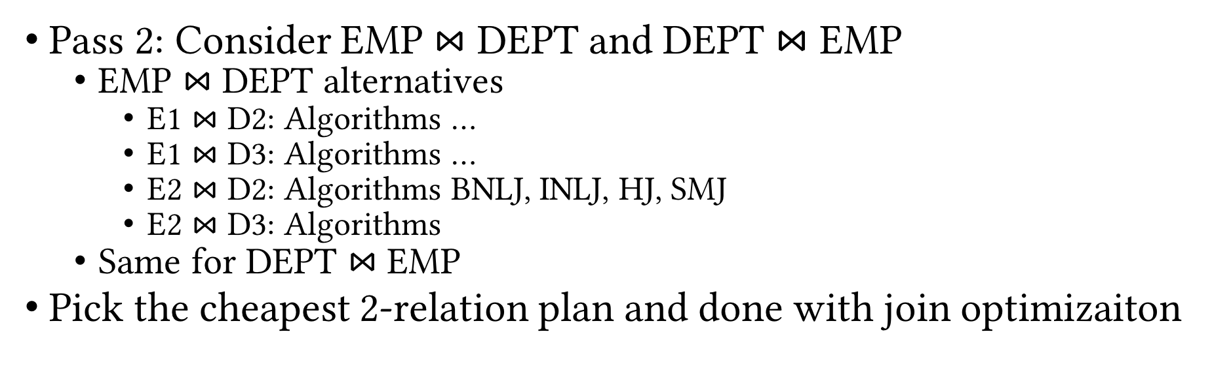
Enumeration of Left-deep Plans: Example (Cont.)
Employee(SSN, eName, Address, Salary, DeptID)
Department(DeptID, dName, Floor, Manager)
SELECT eName
FROM Employee JOIN Department
WHERE dName = ’Toy’
Employee: B+tree on SSN and DeptID
Department: B+tree on DeptID and dName
Pass 2: Consider EMP $⋈$ DEPT and DEPT $⋈$ EMP
EMP $⋈$ DEPT alternatives
E1 $⋈$ D2: Algorithms …
E1 $⋈$ D3: Algorithms …
E2 $⋈$ D2: Algorithms BNLJ, INLJ, HJ, SMJ
E2 $⋈$ D3: Algorithms
Same for DEPT $⋈$ EMP
Pick the cheapest 2-relation plan and done with join optimizaiton

Slide 57
System R Optimizer (Cont.)
ORDER BY, GROUP BY handled as a final step
Only “join” relations if there is a connecting join condition, i.e. avoid Cartesian products if possible
Still exponential in number of tables to join

Slide 58
Recap
Plan generator and cost estimator work in tandem
Rules determine what PQPs are enumerated
Logical: algebraic rewrites of LQP
Physical: operation implementations and ordering alternatives
Cost models and heuristics help approximating the costs of the PQPs
Active research area
Parametric query optimization, multi-objective query optimization, multiple query optimization, online query optimization, dynamic re-optimization, etc.

Slide 59
Detailed DBMS Architecture
Web Forms
Application Front Ends
SQL Interface
SQL Commands
Query Evaluation Engine
Plan Executor
Parser
Operator Evaluator
Optimizer
Transaction Manager
File and Access Methods
Recovery Manager
DBMS
Concurrency Control
Buffer Manager
Storage Manager
Lock Manager
Disk Space Manager
Index Files
Database
System Catalog
Data Files

Slide 60
Transaction Management
Next Up
Questions?

